Slide 1

Customer Intelligence Analyst

Slide 2

HELLO!
I am Reza Nakhaei, a full stack programmer
For 7 years, I have the honor of working with Irancell in the department of CR.
I completed my studies in associate degree in data communication and bachelor's degree in electricity-communication.
Since 2007, I have experienced the majority of programming languages discretely and continuously in a project-oriented way.
I have worked with the customer intelligence team for the past two years.

Slide 3

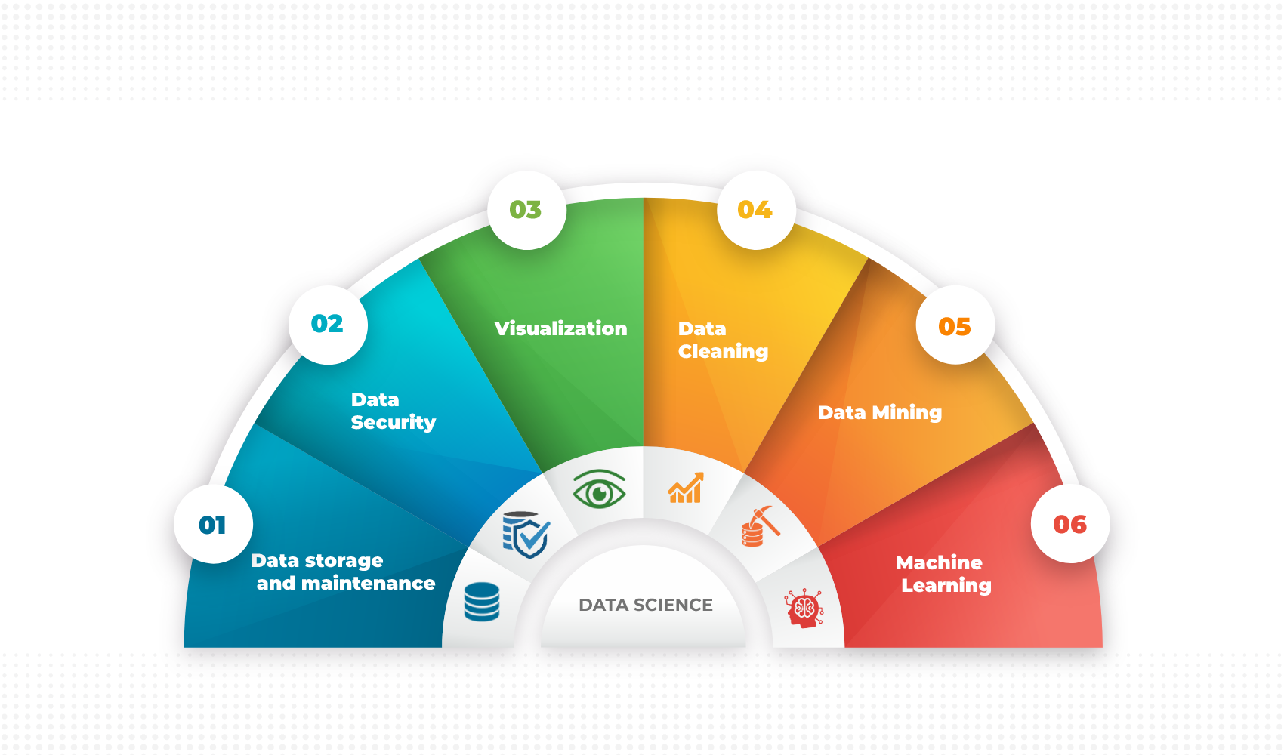
DATA SCIENCE
Data science enables businesses to process huge amounts of structured and unstructured big data to detect patterns. This in turn allows companies to increase efficiencies, manage costs, identify new market opportunities, and boost their market advantage.
علم داده کسب‌وکارها را قادر میسازد تا حجم عظیمی از داده‌های بزرگ ساختاریافته و بدون ساختار را برای شناسایی الگو ها پردازش کنند. این به نوبه خود به شرکت ها اجازه می دهد تا کارایی را افزایش دهند، هزینه ها را مدیریت کنند، فرصت های جدید بازار را شناسایی کنند و مزیت بازار خود را افزایش دهند.

Slide 4
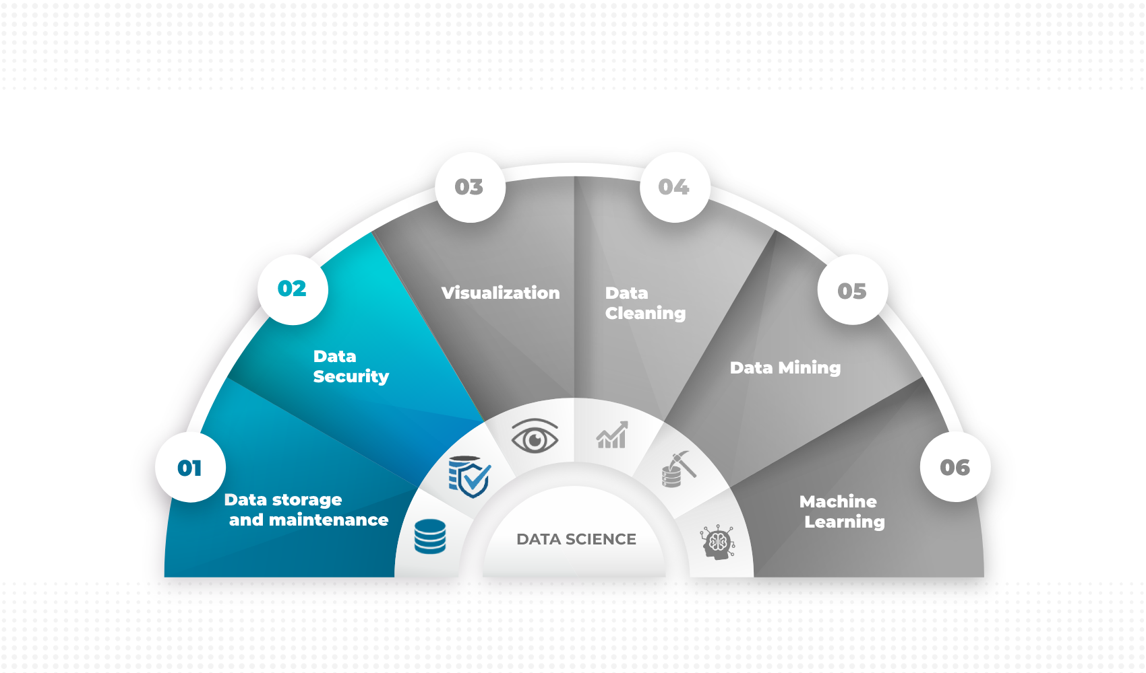


DATA SCIENCE
Connection between databases
Collecting and organizing data
Create procedures for data structures
Prevent data leakage through the user
Data reporting and delivery in different formats
Monitoring and checking data security and the possibility of creating data access
Communicating with other departments to collect information

Slide 5
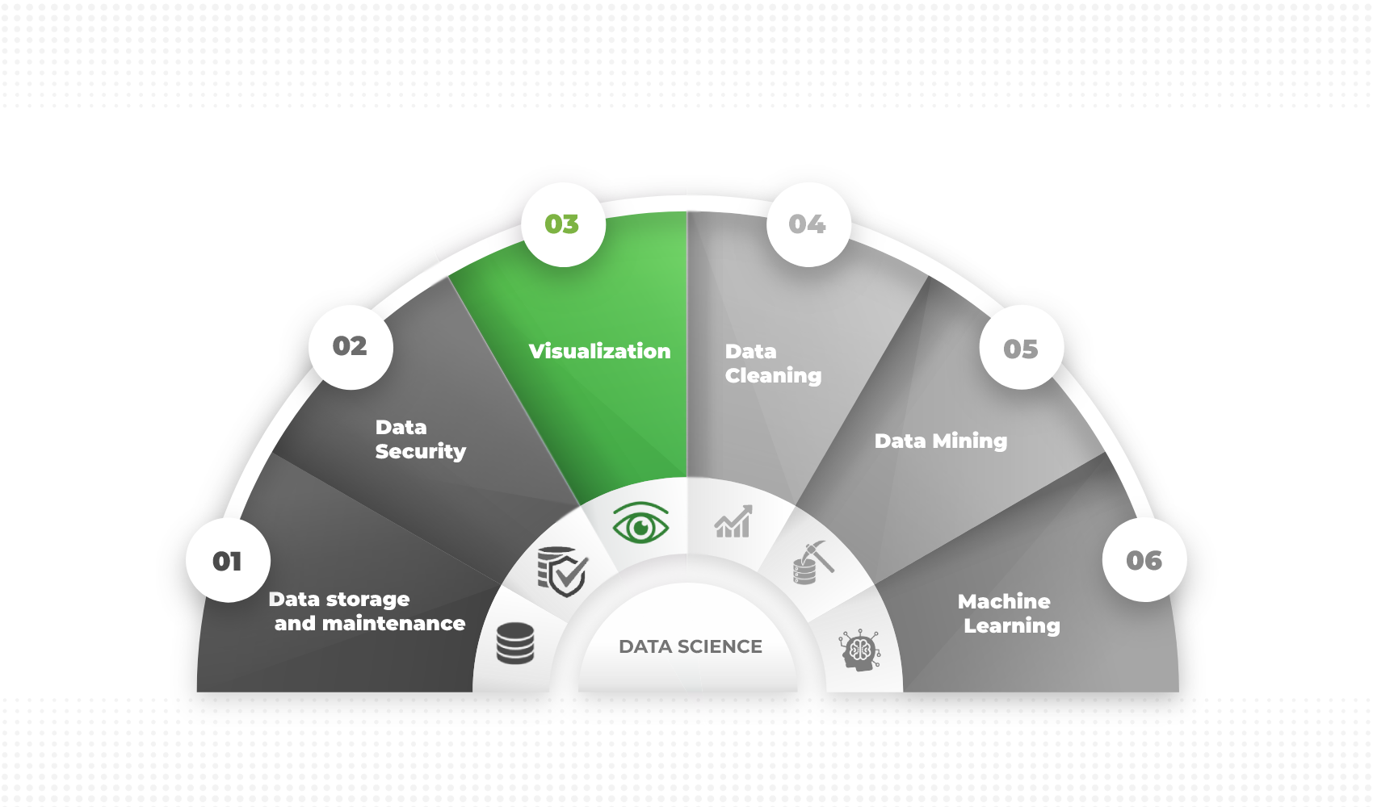
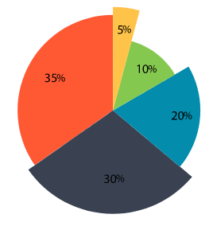
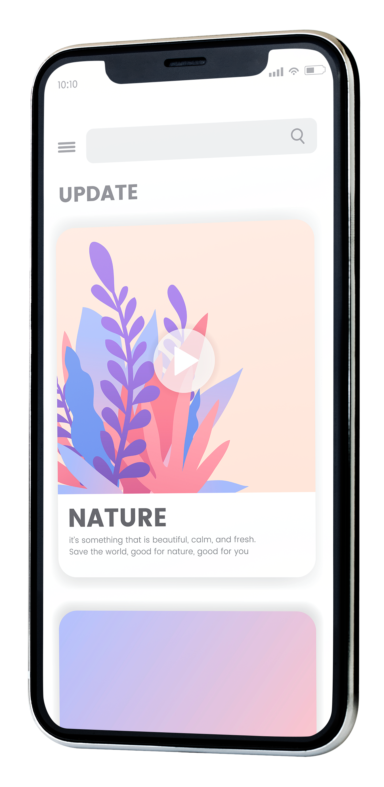
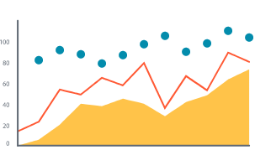

DATA SCIENCE
Design and manufacture of dashboard
Creating interactive pages with the user
Design of conceptual charts
Responsive design on all platforms

Slide 6
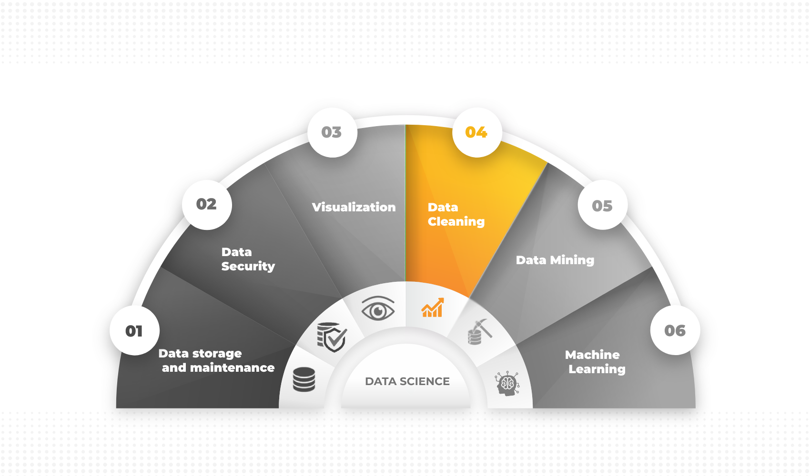
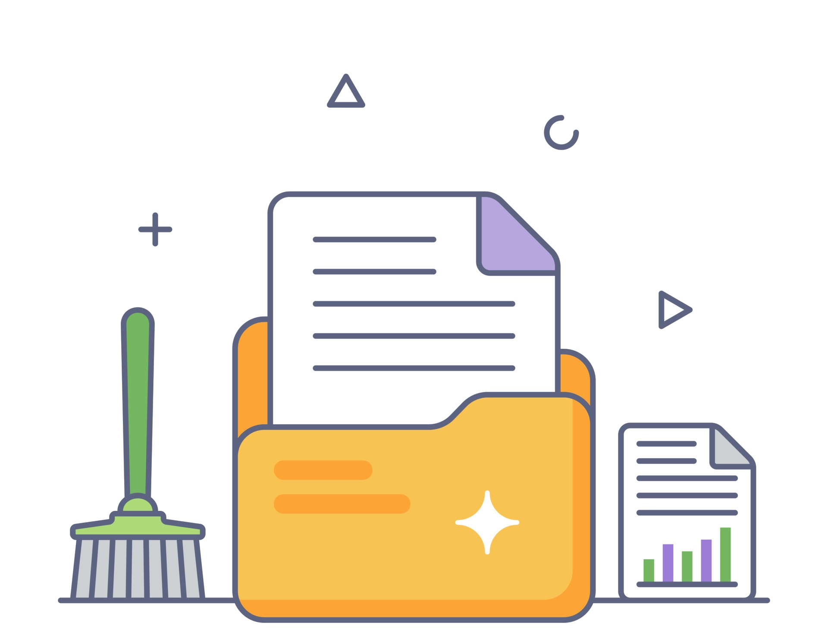
DATA SCIENCE
Doing the following tasks with the help of programming language is 50 times faster than common software
Removing duplicate and irrelevant data
Fix structural errors
Filter out unwanted outliers
Data set validation and quality assurance

Slide 7
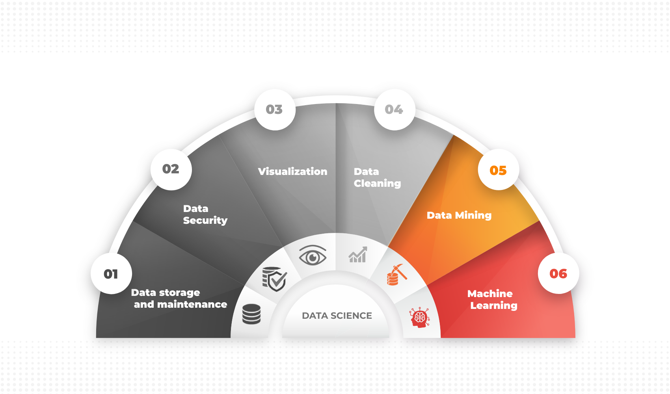


DATA SCIENCE
I am learning in the following parts
Statistical functions distribution and patterns
Deep concepts of theory
Machine learning with R language

Slide 8
Projects in which I participated
In the form of teamwork with the customer intelligence department

Slide 9
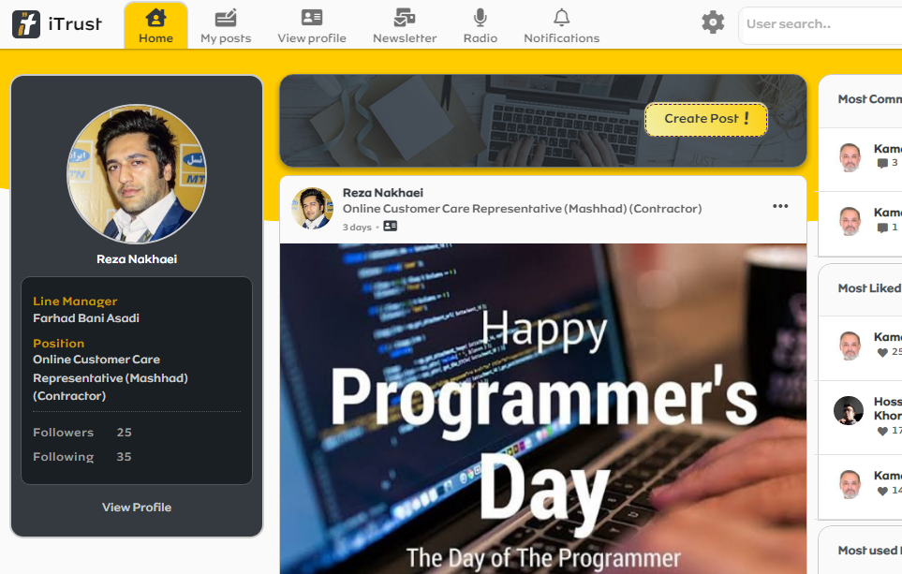
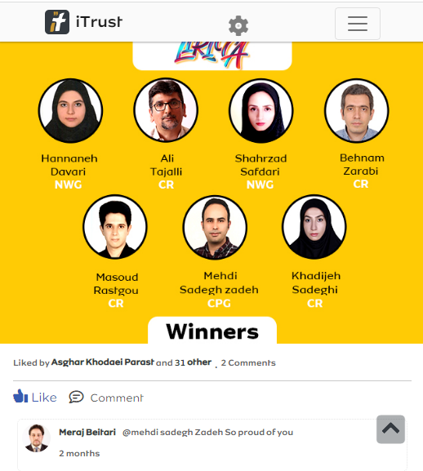
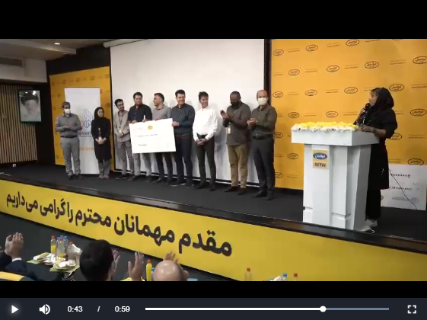
iTrust
Internal social network
Program features
Create personal profiles
Following favorite users
The possibility of registering posts, comments, likes, etc.
Future updates
Ability to record stories
Design and build the Android version
Restructuring the application for connections under the API
Changing and designing a more beautiful front end completely

Slide 10
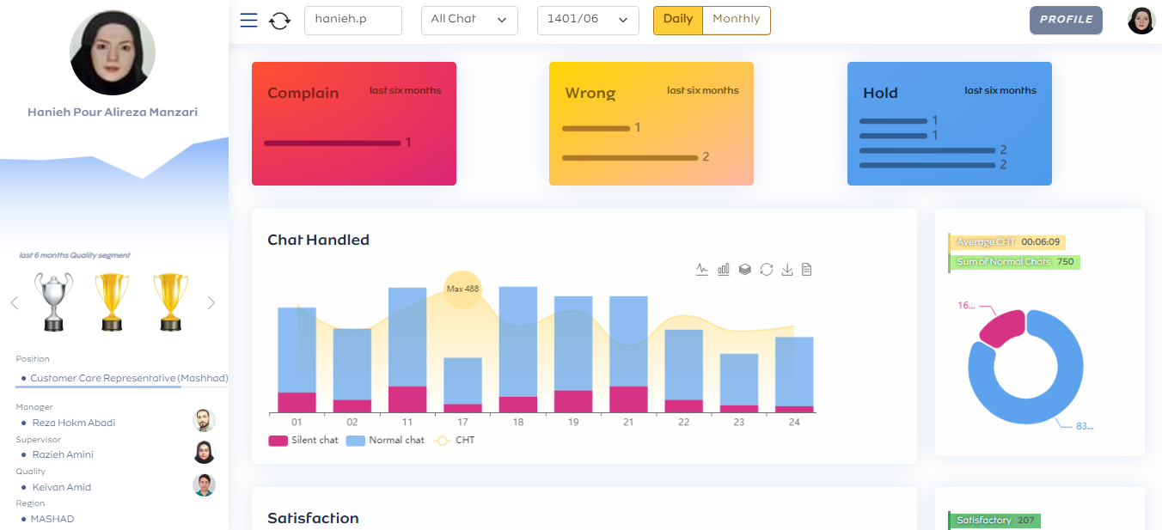
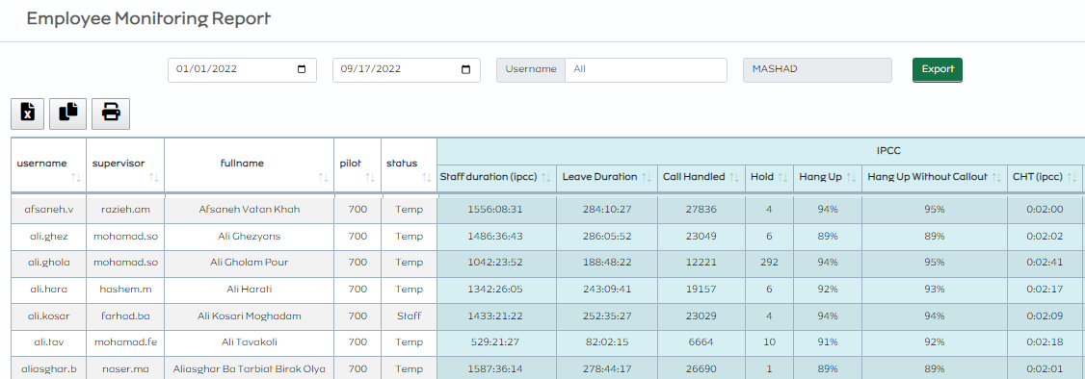
Employee Monitoring
Program features
Get Excel output of each chart
The page to receive the IPF of the employees of each region
Viewing the performance of employees in both solar and Gregorian dates
Embedded in 4 access management, supervision, quality, employee
Future updates
Add ranking of each employee

Slide 11
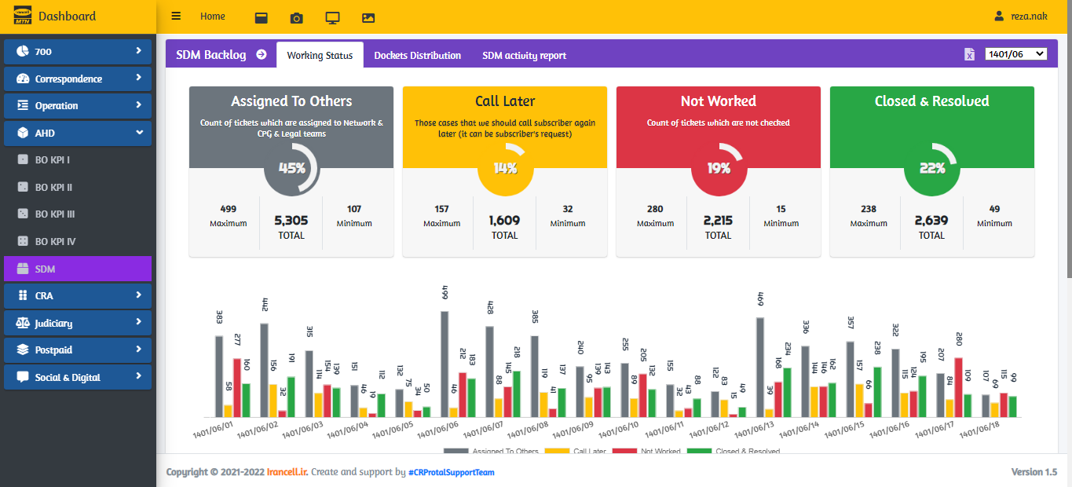
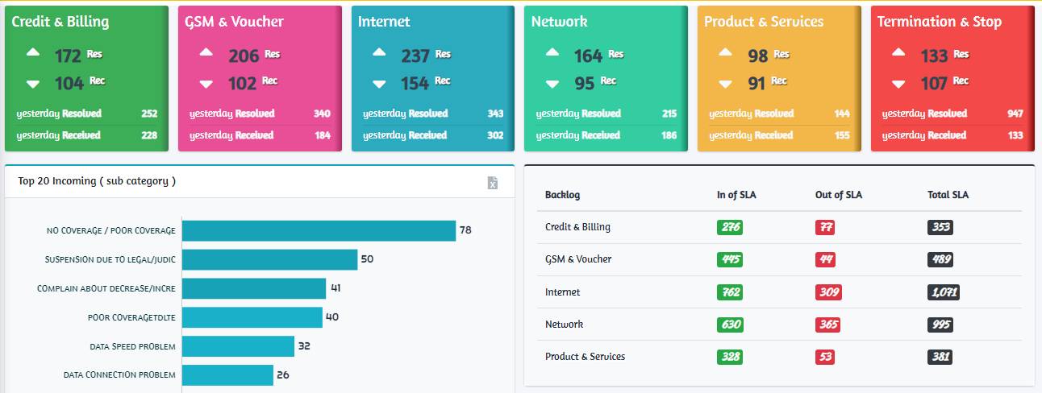
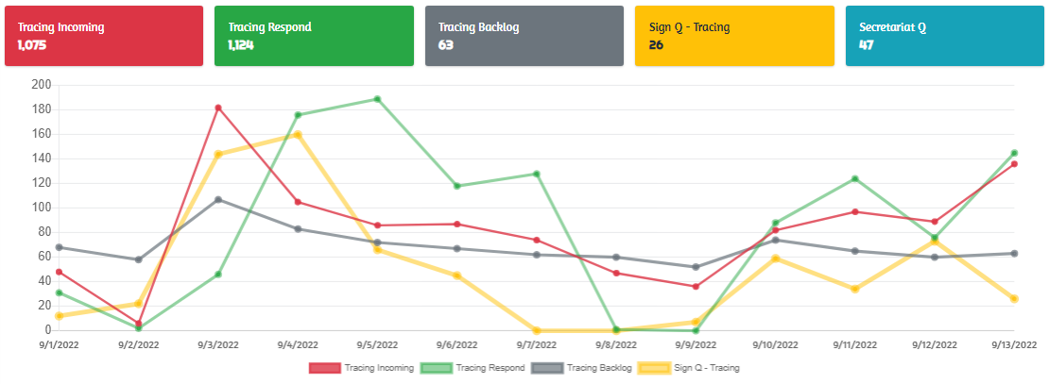
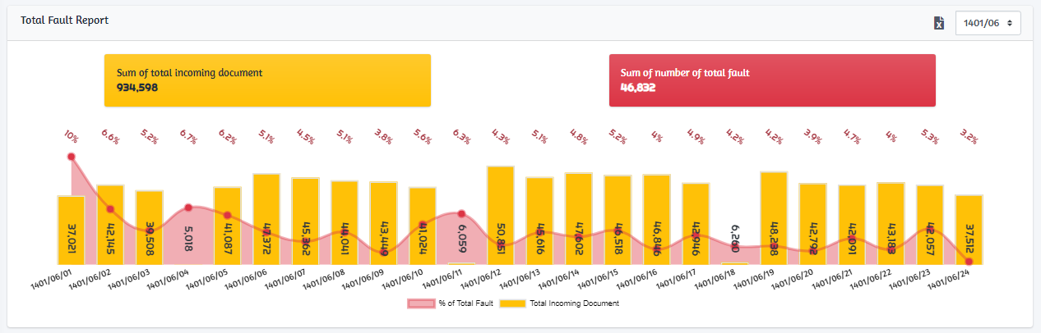
CR Dashboard
Program features
Analysis and design of more than 40 interactive pages related to 8 sections of CR with reporting and visual view for two accesses of managers and supervisors.

Slide 12
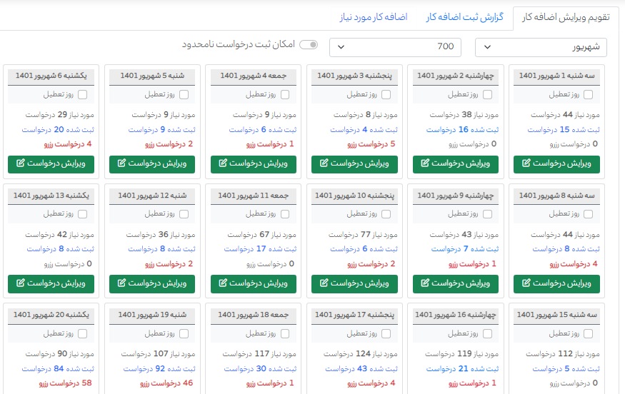
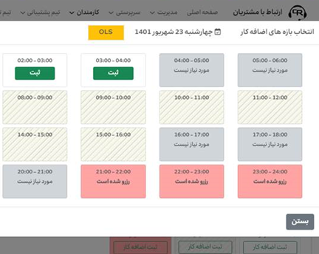
Overtime Panel
Program features
Designing and building the overtime registration page in a systematic way based on the amount of overtime required in different pilots by the workforce team in the following three accesses
Employee : Request for registration and reservation of overtime and reporting
Workforce: Recording the number of required overtime, reviewing and reporting all requests, the possibility of canceling and increasing the number of requests
Managers and Supervisors: Reporting of registered requests of team members

Slide 13
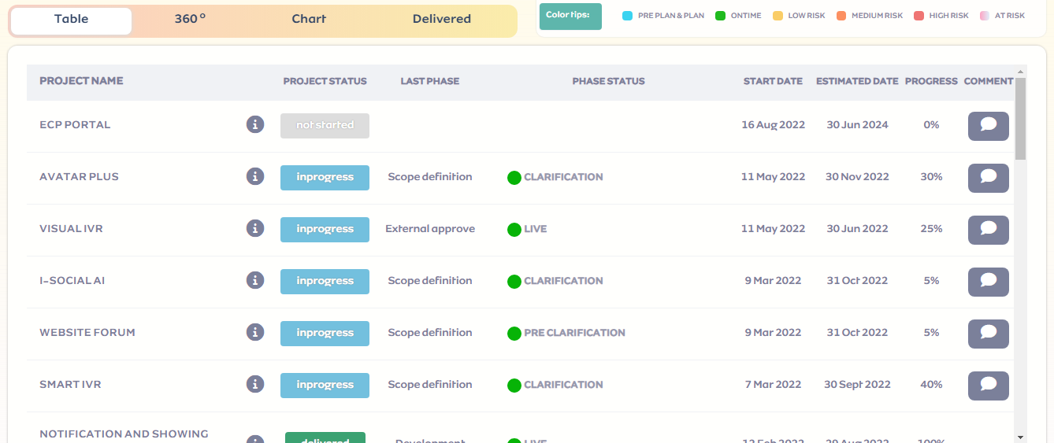
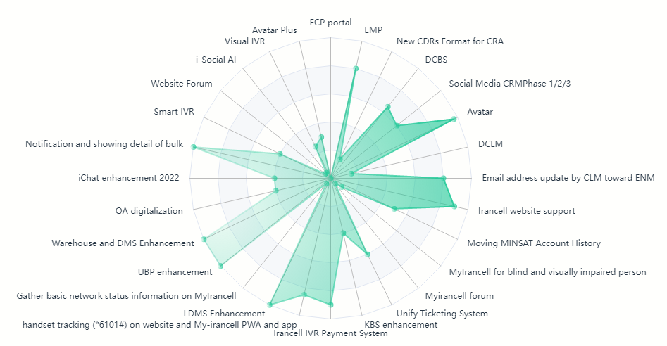
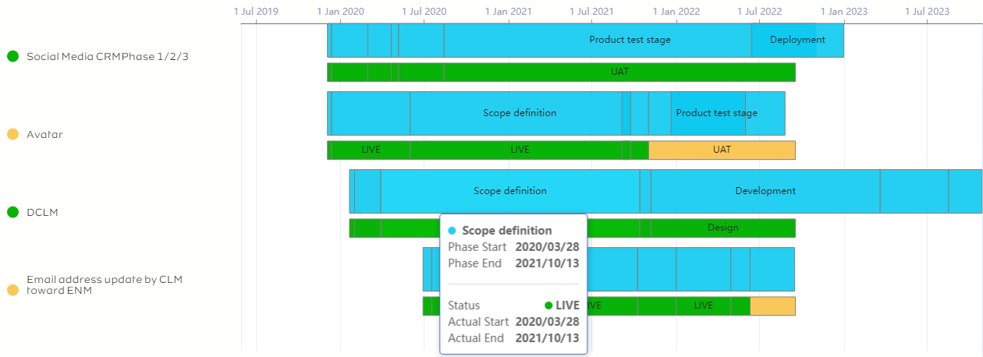
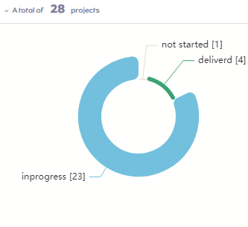
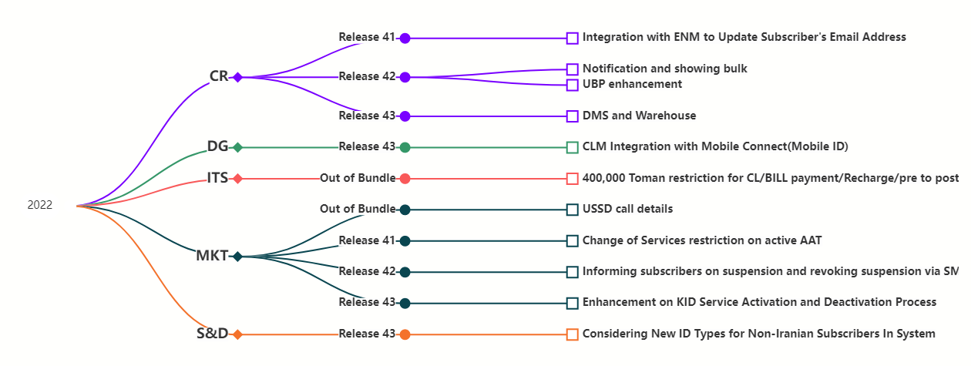
Projects Schedule
Program features
On this page, we have tried to design the schedule of projects in the form of supplementary reports, related charts and smart notifications.

Slide 14
Providing suggestions and solutions

Slide 15
According to the need to receive custom and raw data on a daily or weekly basis from the management of different departments, it is possible to classify a page with access types and create custom requests to do this systemically and in a safe environment against malicious attacks. These requests can be answered in the form of automatic email sending or in various data formats.
According to the company's need to create and classify useful and intelligent work shifts of call center employees to better control service levels and 100% employee participation in emergency situations, patterns can be given for seasonal or occasion forecasts with the help of analysis. created the previous ones in order to reduce the work load of the workforce team.
To check and communicate SL details better and faster, a comprehensive application with graphical design and security at the API level can be created, which includes the following
Showing SL graphically and numerically
Comparing the service level every day to the same day in the previous week for all skill
Comparing the real call offered every day to the same day in the previous week for all skill
Set manual alarm and create Custom template

Slide 16
ایرانسل بزرگترین اپراتور دیتای ایران

